Slide 1

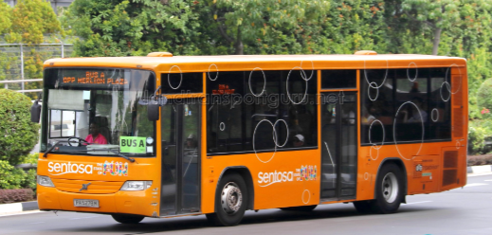

Capstone Project
Presented by: BDA09 Group05 - The Rising Seven
13 Jan 2022
Notes:
Good afternoon everyone, this is BDA09 Group 5 The Rising Seven,

Slide 2



How might we provide better allocation of buses to bus stops to cater to ridership demand?
Data
Adopt a demand forecasting model to help Sentosa Development Corporation (SDC) to preempt the hourly ridership a week ahead to allow SDC Operations team to plan its bus scheduling to cater to the guest demand.
Digital
Include shuttle bus service information in the Sentosa App to allow guests to view the bus arrival times and available capacity real time.
Our Recommendations
More dynamic scheduling ahead of demand surges instead of current fixated schedules.
Potential cost savings to remove under-utilized buses during non-peak hours.
Increase in customer satisfaction as they can use the App to better plan their time in Sentosa
Potential increase in revenue for SDC with more take up traffic on the Sentosa App.
Value & Impact
Notes:
How might we provide better allocation of buses to bus stops to cater to ridership demand?
We recommend :-
1) Having a demand forecasting model to predict hourly ridership at bus stops to allow the operations team to plan their bus schedule a week ahead
2) and include new features in the Sentosa App for visitors to see the bus arrival times and available capacity.
By adopting our recommendations:-
1) The operations team will be able to use these predictions to schedule buses dynamically matching it to demand surges instead of running a fixed bus schedule
2) And this will leads to potential cost savings as under-utilized bus deployed at non-peak time can be removed.
3) Further, customer experience will be improved as they are able to see live bus information through the App which allows them to better plan their time around Sentosa in spending more time at attractions and less waiting at bus stops.
4) Also, this will drive and increase chances of customer using other existing App features such as promotions, attractions and thereby increase the revenue for Sentosa.

Slide 3





Project Modelling Flow
Business Understanding & frame the ​problem ​
Statement​/Hypothesis
Initial Data Understanding & Processing
"How might we provide better allocation of buses to bus stops to cater to ridership demand?"
Data Analysis
- Obtain dataset
- Understand and clean data
Gather insights
from initial data:
- Peak of day
- Highest ridership by bus stop/bus route
- Any correlation between ridership and weather, weekends, etc.
Modelling
Create new features
to improve predictions:
- Average ridership
- Bus frequency
Built a model to predict hourly ridership demand one week in advance
Notes:
How we approach our modelling:-
Firstly, we conducted industry research to understand the business, formulated the problem and framed the problem in a series of hypothesis.
We cleansed, processed and analysed more than 220,000 rows of data and find out the root causes including any correlation between the ridership data and other variables.
Next, we created new features such as average ridership and bus frequency and used them to built our model to generate hourly predictions one week in advance.

Slide 4
Key Assumptions/Limitations
Total rider coming in and out are the same number.
Bus stops and bus routes cannot be removed.
3. No key events or promotions during the period of data provided (Jan – Mar 2021) due to COVID-19 SMM measures.
4. Maximum bus capacity is 50 pax due to COVID-19 SMM measures.
Notes:
Some assumptions we had:
1) We noticed the bus detection system was not able to pick up the alighting and boarding of every rider. Hence we assume the total riders in and out are the same and use the average ridership as basis for all our computations.
2) We understand bus stops and bus routes cannot be removed.
3 & 4) Because of Covid, we understand there are no major events or promotions in these data months and the maximum bus capacity was reduced to 50 pax. We used this capacity number to derive bus frequency which is a key feature in our analysis and modelling.

Slide 5
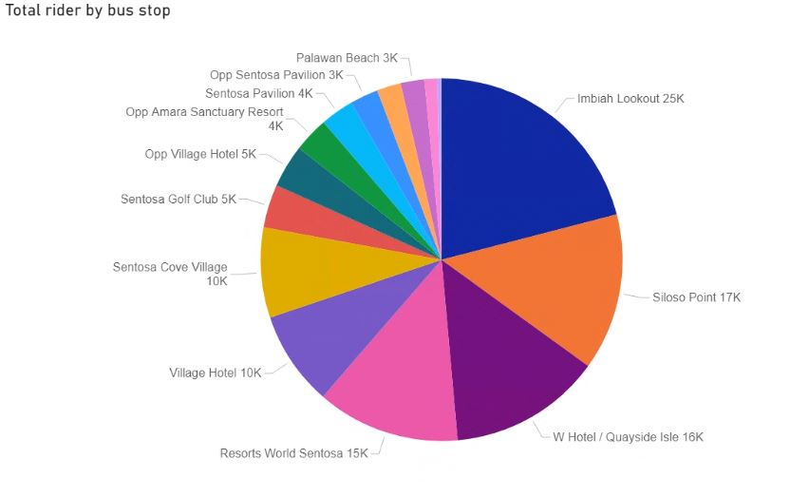
Imbiah Lookout has highest total ridership for all Bus Stops
Imbiah lookout has the highest ridership of all bus stops.
*Beach Station is excluded in this analysis as it is a bus interchange which naturally will have high ridership.
Our focus is on the bus stops between the interchange.
Source : 3 months actual ridership data (Jan to March 2021) from SDC
Notes:
Given that it is not possible to remove any bus stops or routes, we decided to focus on the bus stop with the highest ridership and use it as first test subject to run our demand forecasting model.
Beach station is excluded in this analysis because it is a bus interchange which naturally will have a high ridership.
Per our analysis of Jan to Mar data shown in the pie chart here, Imbiah lookout has the highest number of riders.

Slide 6
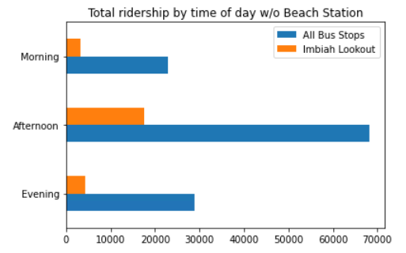
Afternoon is the peak for all buses (including Imbiah)
07:00 – 11:59
12:00 – 17:59
Sentosa visitors generally prefer to take the bus in the afternoon compared to other times of the day.
This suggests that most of the bus congestion happens in the afternoon.
18:00 – 23:59
Source: 3 months actual ridership data (Jan to March 2021) from SDC
Notes:
We plot a graph from Jan to March to analyse the total ridership at the time of the day.
Overall, afternoon is the peak of all the bus routes.
We see the same trend and peak at Imbiah Lookout.

Slide 7
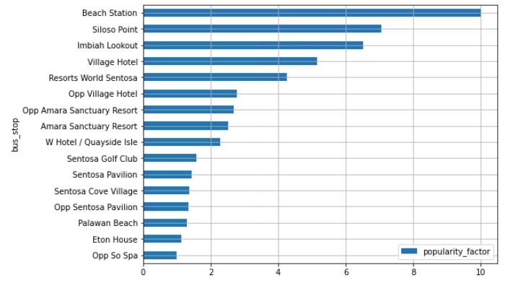
Imbiah Lookout is in the top 3 most popular bus stops
Source : 3 months actual ridership data (Jan to March 2021) from SDC
*Refer to appendix for more details on popularity index
Imbiah Lookout and Siloso Point are the top bus stops with high popularity among all bus stops
The popularity factor has a correlation with the total rider. The higher the score, there will be more passengers.
Notes:
We have created a popularity index considering 4 components which are attractions, FnB, Hotels and Transport.
According to our popularity index, we can see that Imbiah Lookout is one of the top 3 popular bus stops

Slide 8
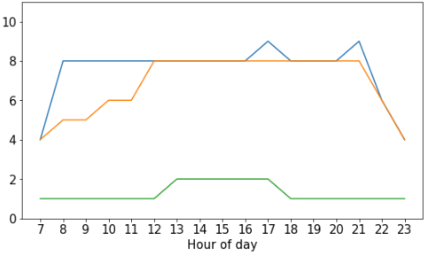
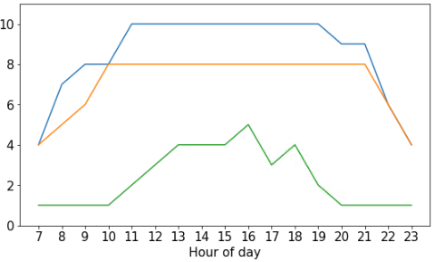
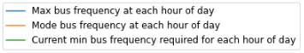
Bus Frequency of Imbiah Lookout
Weekdays
Weekends and holidays
Source : 3 months actual ridership data (Jan to March 2021) from SDC
Based on the highest ridership for every hour and taking the maximum bus capacity of 50pax, we identified that the actual bus deployment required to support the highest ridership could be more than required. There is a possibility of under-utilised buses using the current fixed bus schedule.
Notes:
We now look at the bus frequency which is an important feature that we created using the ridership data against the bus capacity of 50pax per bus.
The reason for calculating bus frequency is because we know that in 1 hour, Sentosa deploys 1 bus every 15mins and we wanted to get the number of buses that is able to pick up all passengers that are in that bus stop at every hour.
We plot the chart based on the Max, Mode, and minimum requirement of bus frequency for each time of the day
The Blue Line refers to the highest value and the Orange Line refers to the most frequent amount of buses deployed at that hour.
The Green Line refers to the minimum value required to support the maximum total ridership for that time.
For example if we look at the weekday chart, the minimum required bus frequency throughout the day is between ONE to TWO buses instead of the current fixed bus schedule of 8 buses per hour.
As we visualize the trend of the two charts, we can see that the Green Line deployed within each hour of the day is lower than the Max and Mode of the bus frequency.
This means that the minimum bus deployment required to support the maximum total ridership at Imbiah Lookout can be more than required.
Later on, we will continue to use this Green Line, our minimum bus frequency, to compare with our prediction results in our demand forecasting model.

Slide 9
Feature Selection
Features
Internal
(Provided by Sentosa)
External
Holiday
Weather²
Weekend
Weekday
Public Holidays, School Holidays¹
Rain
Average of Total Ridership
(Sum of Total In & Total Out/2)
*Predicted Variable
Bus Frequency
(Total Ridership/50)
Bus Routes /
Bus Stops
Bus to Amenities / Attraction Details
Day of Week
Ridership
Source: 1 www.moe.gov.sg/news/press-releases/20200817-school-terms-and-holidays-for-2021; 2 www.weather.gov.sg
Notes:
slide 1:features
Using data provided, we created features for
day of the week and our target variable average ridership. From there we created the bus frequency metric dividing ridership by 50.
Using external data, we created the flags for rain and holiday.

Slide 10

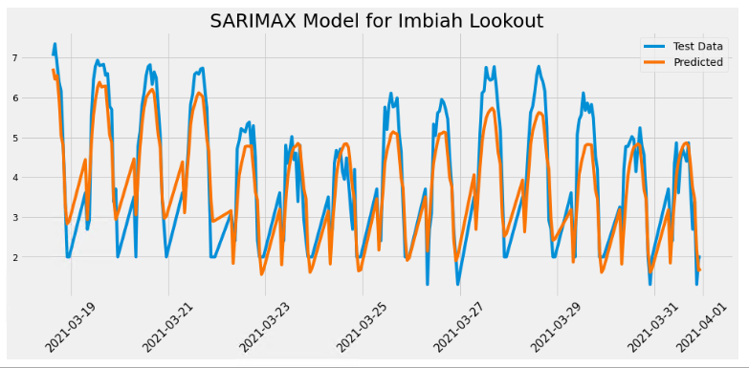
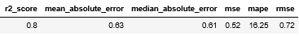
Time Series Modelling (SARIMAX)
We took a log of the target variable for scaling
Train/Test Split: 0.85/0.15
SARIMAX Model was applied to account for seasonal trends and exogenous factors.
Rain, holidays and weekends stood out in the modelling process.
R2 score and Mean Average Percentage Error (MAPE) to determine accuracy of our model.
Source : 3 months actual ridership data (Jan to March 2021) from SDC
Notes:
slide 2: model
To train the model, we used a train/test split of .85 and used SARIMAX to account for seasonal trends and exogenous variables. In order to scale the target variable we also took a log of it. We used auto-arima and looping to get the best accuracy. Our best result was an R2 score of 0.8 and mean average prediction error of 16.25%.

Slide 11
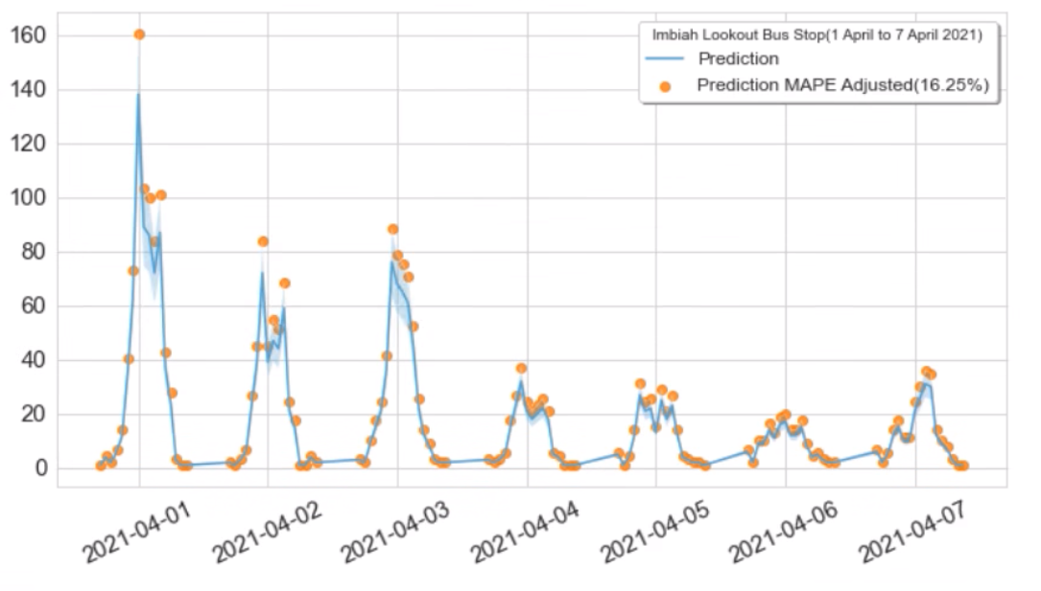
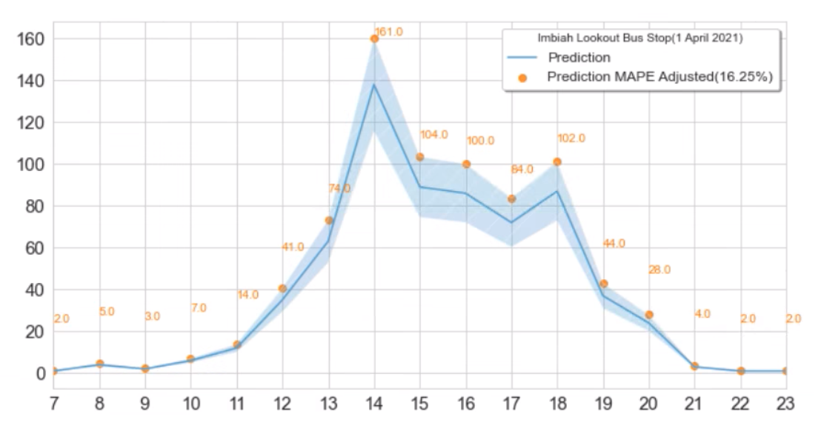
Ridership Predictions for 1st Week of April 2021
Saturday (Weekend)
Good Friday (PH)
Weekly Predictions
Hourly Prediction for 1 Day
Notes:
slide 3:
We predicted ridership for the first 7 days of April, to cover the variations across the week. To buffer for error we also show a mape-adjusted prediction denoted by the orange points on the graph.
As seen in our prediction, similar trends are observed, with high ridership starting on 1st April, a Thursday. Higher than average ridership continues on Friday, a public holiday, and 3rd April, a Saturday. This trend only tapers off on Sunday.
Looking at the hourly prediction by day, we see the same mid-day peaks that occur in the afternoon between the hours of two to six PM.

Slide 12
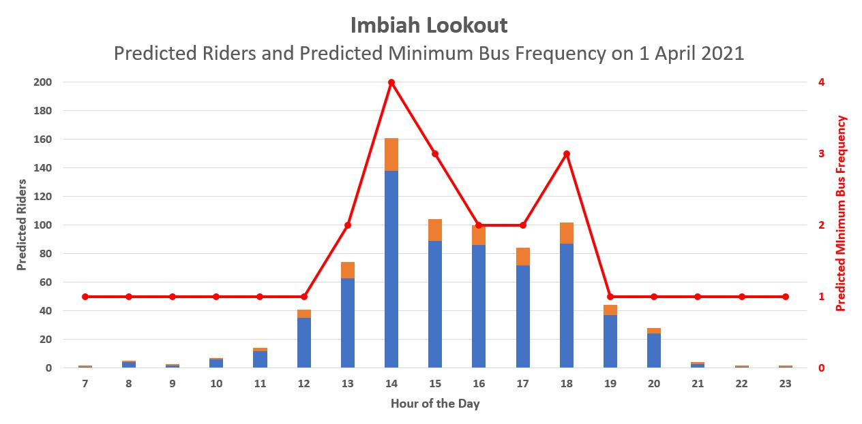
Predicted Minimum Bus Frequency Required on 1st April 2021
Difference in minimum required bus frequency due to the peaks in demand
Legend
Predicted
Ridership
Additional buffer of 16.25% according to MAPE Value in Prediction Model
Predicted Minimum Bus Frequency
Actual Weekday Minimum Bus Frequency Required (Derived from EDA)
Notes:
slide 4:
Building upon our ridership prediction of 1st April and using the MAPE value as buffer, we calculated the bus frequency based on the maximum bus capacity of 50pax.
We then get the minimum required bus frequency as seen in the red line in the chart. We see a surge in demand at 2pm and 6pm where approximately 4 and 3 buses would be needed that hour respectively.
Overlaying this with the actual bus frequency derived from our EDA, we see that the minimum requirement hovers around 1 to at most 2 buses.
Comparing that with our prediction, we see then that the minimum requirement differs during certain hours of the day where ridership surges.
To that end, we propose that the usage of our model would allow for a better allocation of buses to meet demand on a dynamic rather than fixed frequency basis.

Slide 13
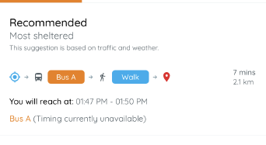
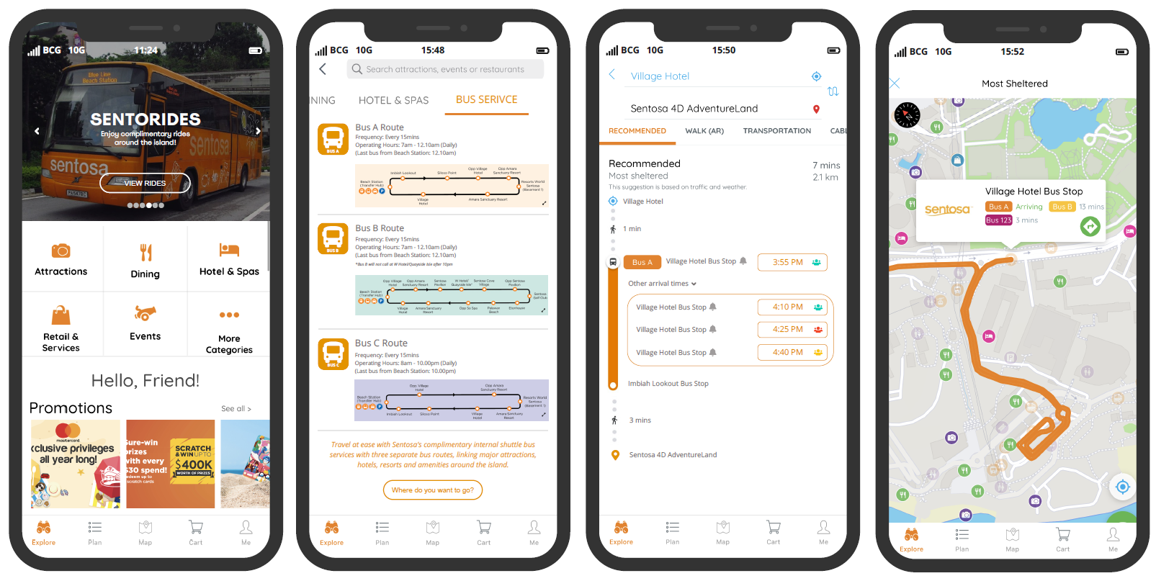

Adding new features in existing Sentosa App Shuttle bus services, real time bus arrival and its occupancy
Current Design – Missing time of arrival & available capacity
Proposed Wireframes
2
1
3
Proposed Design - Real time bus arrival & available capacity
3
1
Include Sentosa Shuttle bus Services
2
Include additional info page on the available routes
3
Include breakdown of bus arrival time and bus capacity
Notes:
Apart from the prediction model, we also came up with another solution through digital means.
We notice that the exiting Sentosa App which was free for download has no mention of the complimentary shuttle services offered by Sentosa.
Therefore, we came up with a few wireframes to include these buses and their route details, as well as information on the actual bus arrival time and available capacity as seen in the 3rd wireframe. Users can also be notified of the specific time for their rides.
These information will help visitors be aware of these services and make informed decision in the planning of their routes without waiting too long for buses.
Acquisition of user ratings and feedback can certainly be included into the app for further analysis and taken into consideration for our model in the next phase.

Slide 14



Next steps
2 Months
4 – 5 Months
- AB Testing on Dashboard & user feedback
Live on App and Dashboard
Immediate
- Acquire longer period data
- Consider additional features
- App Soft Launch
6 Months
- Model Implementation (CSV)
- Improve & Optimise Model (other bus stops)
- Build App Features prototype
3 Months
- Develop Dashboard prototype
- Feedback on Model (CSV) and integrate into Dashboard prototype
- User Testing on App
Notes:
So in our next steps, we are looking at a time frame of 6 months before going live:-
As time series model needs more data and information to learn and generate more accurate predictions,
in our immediate next step, we will need to improve and optimise our model by obtaining data over a longer timeframe, consider additional features such as events and programs, and tourist’s segmentation for any seasonal pattern. We can then train and test the model to include other bus stops.
In the next 2 months, we will implement the model with operations team while developing the dashboard and building the app prototype with the new features.
Thereafter, we will gather feedback on the model, integrate it to the dashboard as well as test the new app features with users.
Subsequently, we will conduct AB testing on the dashboard whilst doing a soft launch for the app.
Finally, within 6 months, we target to go live on both the app and dashboard.

Slide 15






Our project team
Lee Kin Nam
Poon Wei Yuan
Koh Lay Hon (Jac)
Wesley Teo
Wong Yong Lin
Evelyn Yong
Notes:
Thank you for listening, this project is proudly brought to you by the rising seven! We are now open to any questions!

Slide 16
Q & A

Slide 17
Appendix

Slide 18
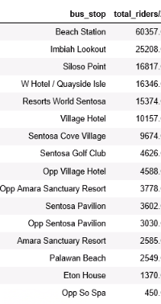
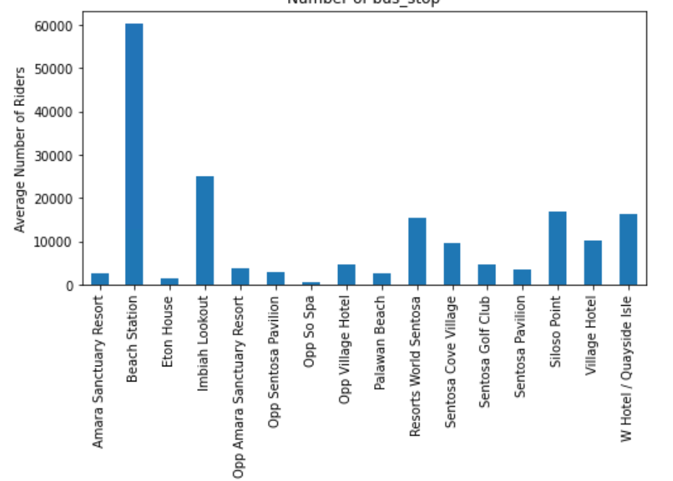
Total ridership for bus stops (including Beach station)
Analysing average number of riders against bus stops
60,357
25,208
16,817

Slide 19
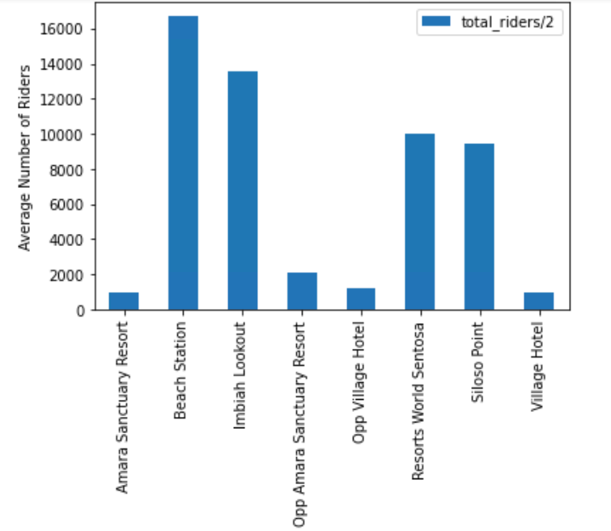
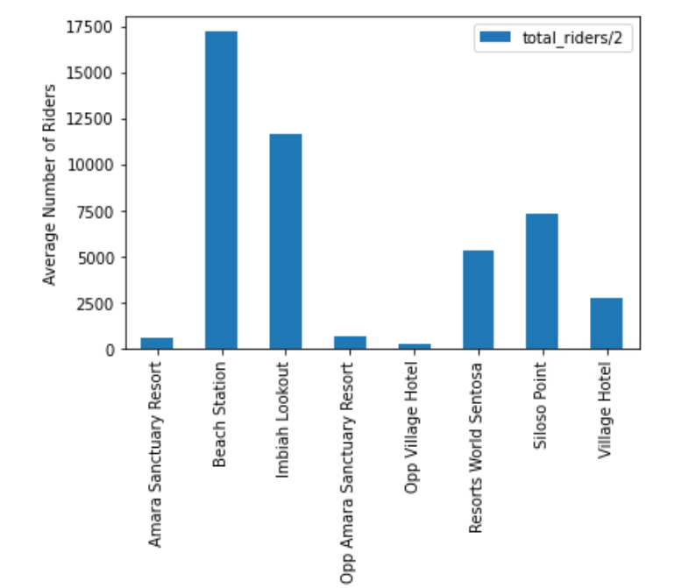
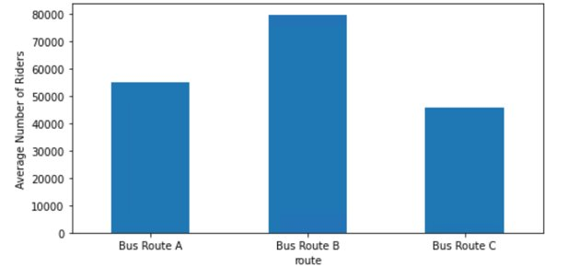
Imbiah Lookout and Siloso point are the top 2 most popular bus stops (ridership)
Bus Route A
Bus Route C
All 3 Routes

Slide 20
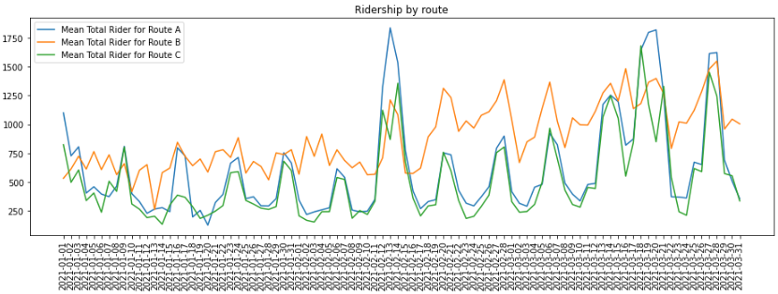
Total ridership by route

Slide 21
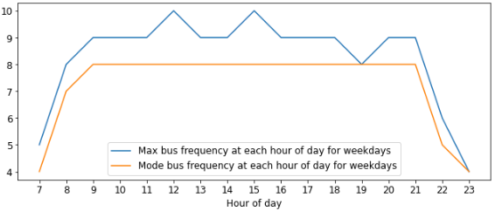
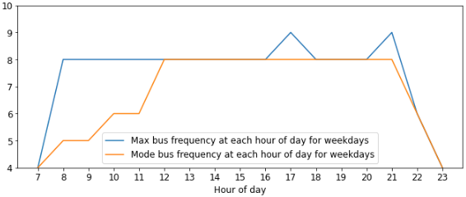
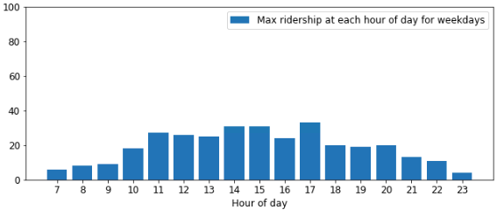
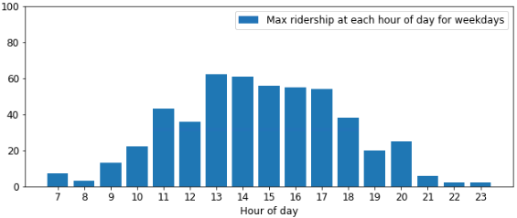
Bus Frequency of top bus stops Siloso Point and Imbiah Lookout (Weekday)
Siloso Point
Imbiah Lookout
Based on maximum bus ridership within each hour and bus capacity of 50, actual frequency of buses deployed within each hour on weekdays is higher than required.

Slide 22
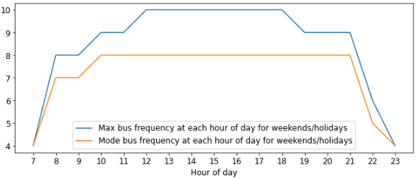
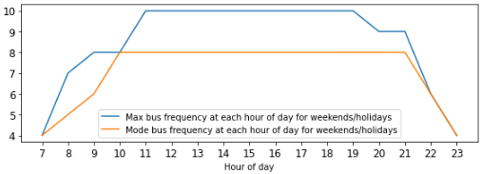
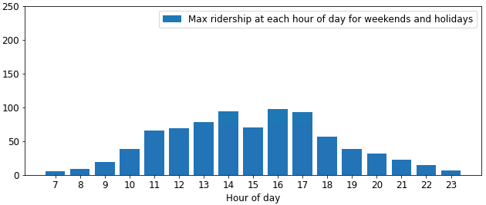
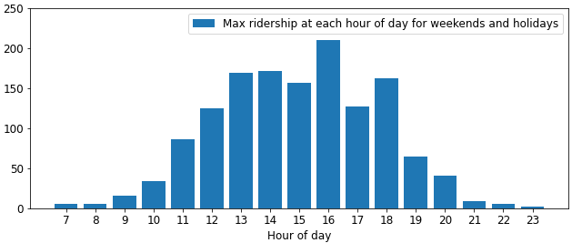
Bus Frequency of top bus stops Siloso Point and Imbiah Lookout (Weekend/holidays)
Siloso Point
Imbiah Lookout
Based on maximum bus ridership within each hour and bus capacity of 50, actual frequency of buses deployed within each hour on weekends is higher than required.

Slide 23
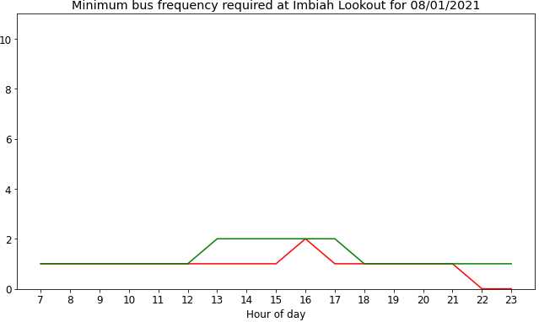
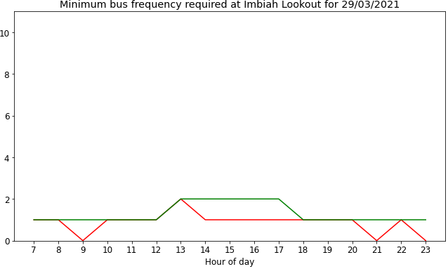
Comparing Minimum Bus Frequency Required: Selected Weekday vs 3 Months of Weekdays Data
Notes:
SANITY CHECK – by selected 2 sample days

Slide 24
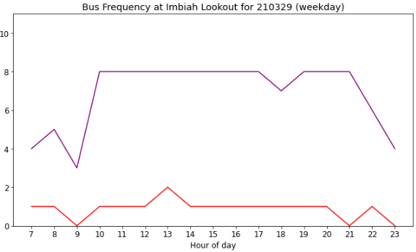
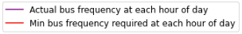
Select Weekday Bus Frequency Comparison: Actual Bus Deployed vs Minimum Bus Frequency Required

Slide 25
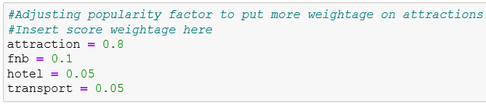
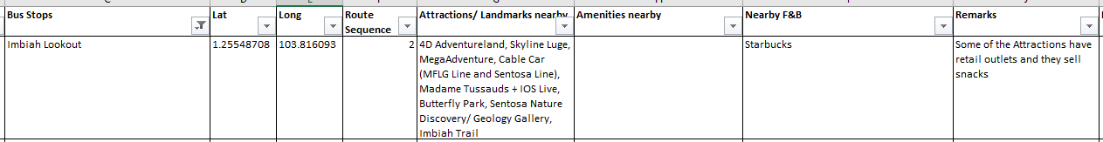
Calculation for Popularity Factor
The score for Popularity Factor is calculated with the following weightage.
We put Attraction as the highest percentage as we want to focus on guests more interested in Attractions compared to F&B and Hotels.

Slide 26
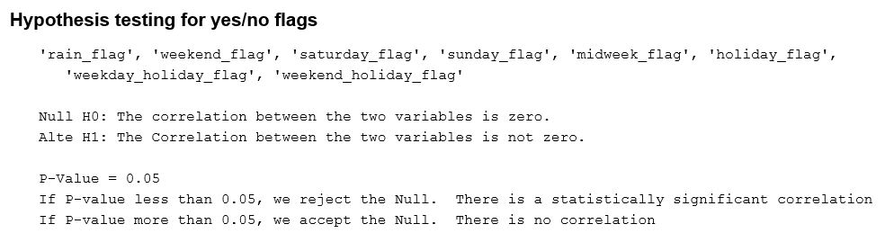
Hypothesis Testing for Correlation between Variables
Mannuwhitneyu test | Rain flag | Weekend flag | Saturday flag | Sunday flag | Midweek flag | Holiday flag | Weekday Holiday flag | Weekend Holiday flag
P-Value | 0.00 | 0.00 | 0.00 | 0.00 | 0.99 | 0.00 | 0.00 | 0.00
Null H0 | Reject | Reject | Reject | Reject | Accept | Reject | Reject | Reject
Variable flag and Total Riders are correlated if P-Value is less than 0.05
The variable flag will affect the total ridership if they are correlated.
Notes:
Sharpiro to test if it's normally distributed, if it's not, use Mannuwhitneyu

Slide 27
Appendix:
Modelling Test For Daily Prediction

Slide 28
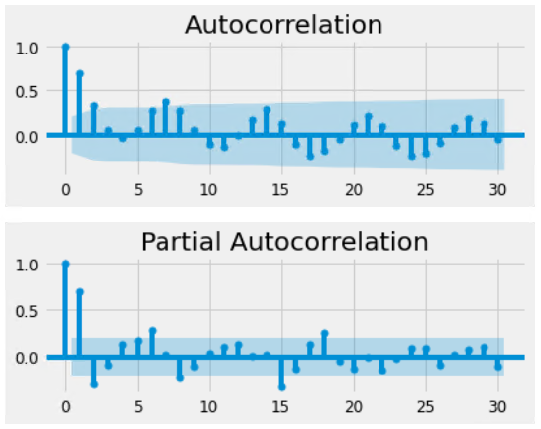
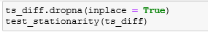
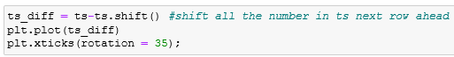
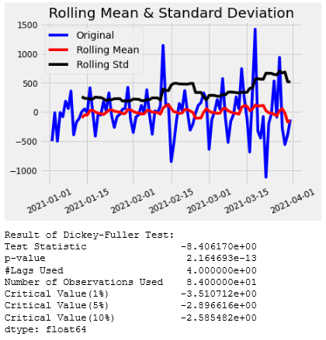
Preprocessing for Modelling Test for Daily Prediction
TS with Difference Technique & Stationarity Test
TS's ACF & PACF

Slide 29
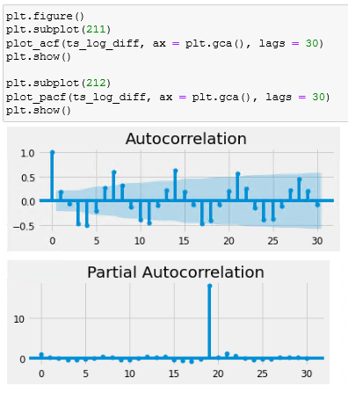
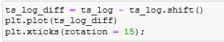
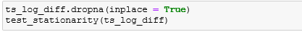
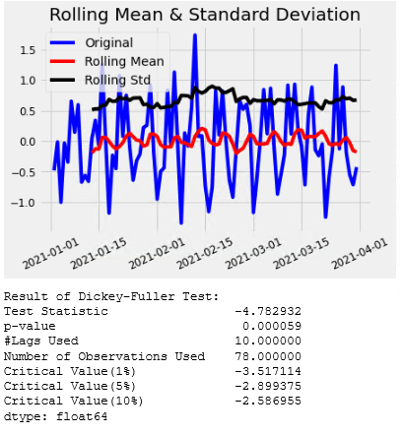
Preprocessing for Modelling Test for Daily Prediction
TS Log Transformed with Difference Technique & Stationarity Test
TS Log Diff's ACF & PACF

Slide 30
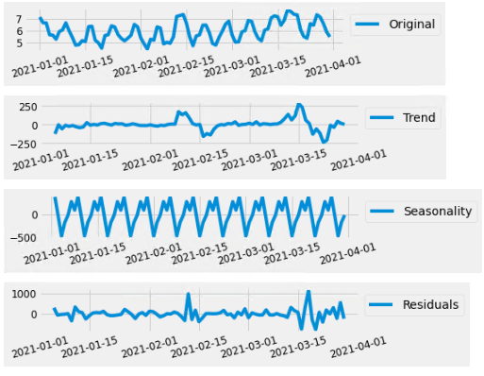
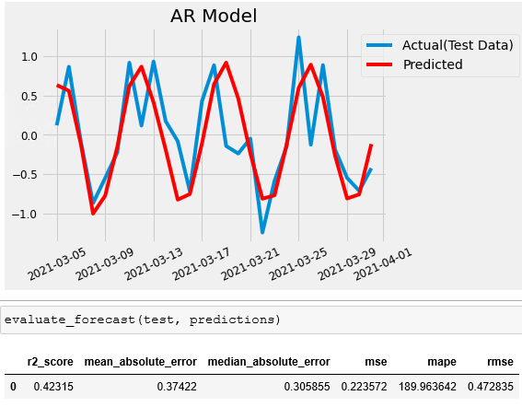
Modelling Test for Daily Prediction
TS Diff's ACF & PACF
AR Model with TS Diff (No Exog Parameters)

Slide 31
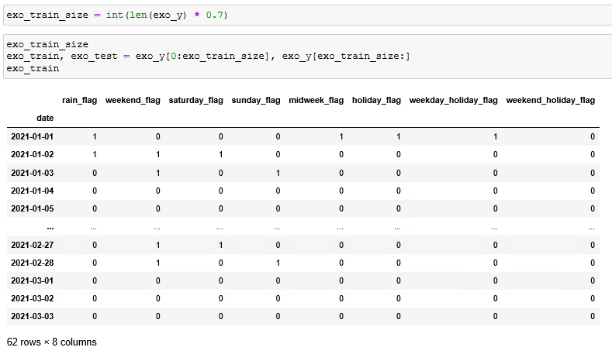
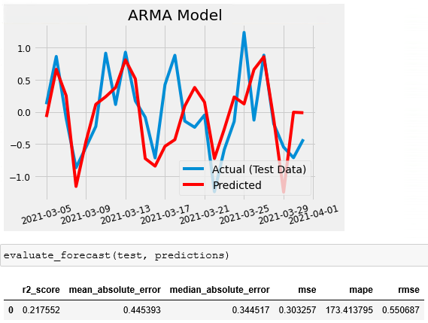
Modelling Test for Daily Prediction
ARMA Model with TS Diff(With Exog Parameters)
Exog Variables Tabular Format

Slide 32
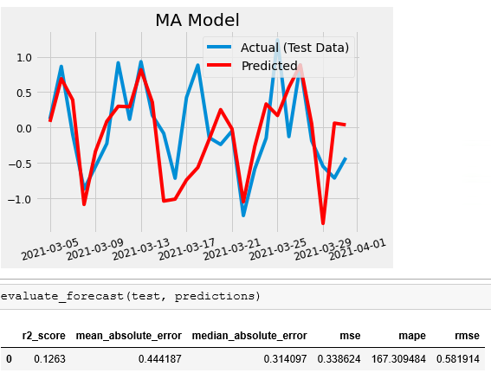
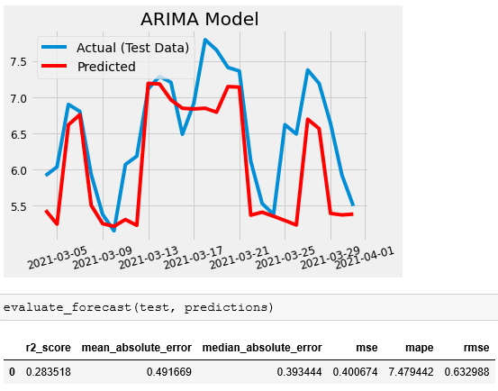
Modelling Test for Daily Prediction
(Moving Average & Arima)
MA Model With TS Diff (With Exog Parameters)
ARIMA Model with TS Log (With Exog Parameters)

Slide 33
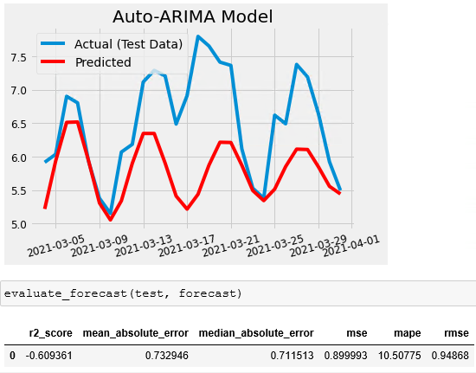

Modelling Test for Daily Prediction
(Auto Arima & Auto Sarima)
Auto Arima Model With TS Diff (With Exog Parameters)
Auto Sarima Model with TS Log (With Exog Parameters)

Slide 34



Modelling Test for Daily Prediction
(Tune Sarimax & Tune Sarima)
Example of Tune SARIMAX Model With Ts Log, Different Combination of PDQ, Seasonal PDQ (With Exog Parameters)
Tune Sarima Model with TS Log
(With Exog Parameters)

Slide 35

Modelling Test for Daily Prediction
(Sarimax)
Sarimax Model with TS Log(With Exog Parameters)

Slide 36
Appendix:
Modelling Test For Hourly Prediction

Slide 37


Preprocessing for Modelling Test for Hourly Prediction

Slide 38


Preprocessing for Modelling Test for Hourly Prediction

Slide 39

Modelling Test for Hourly Prediction – Imbiah Lookout
(Sarimax - Train)

Slide 40
Modelling Test for Hourly Prediction – Imbiah Lookout (Sarimax - Test)

Slide 41

Modelling Test for Hourly Prediction – Siloso Point
(Sarimax - Train)

Slide 42


Modelling Test for Hourly Prediction – Siloso Point
(Sarimax - Test)

